Slide 1
Problem Statement Title: Conversational Fashion Outfit Generator powered by GenAI
Team Name: 686157-U5D46V3X

Slide 2

Team members details
Team Name | 686157-U5D46V3X
Institute Name/Names | Thapar University (TU), Patiala
Team Members > | 1 (Team Leader) | 2 | 3
Name | Harshit Sharma | Prateek Rustagi | Aarushi Abrol
Batch (Passing Year) | 2024 | 2024 | 2024

Slide 3

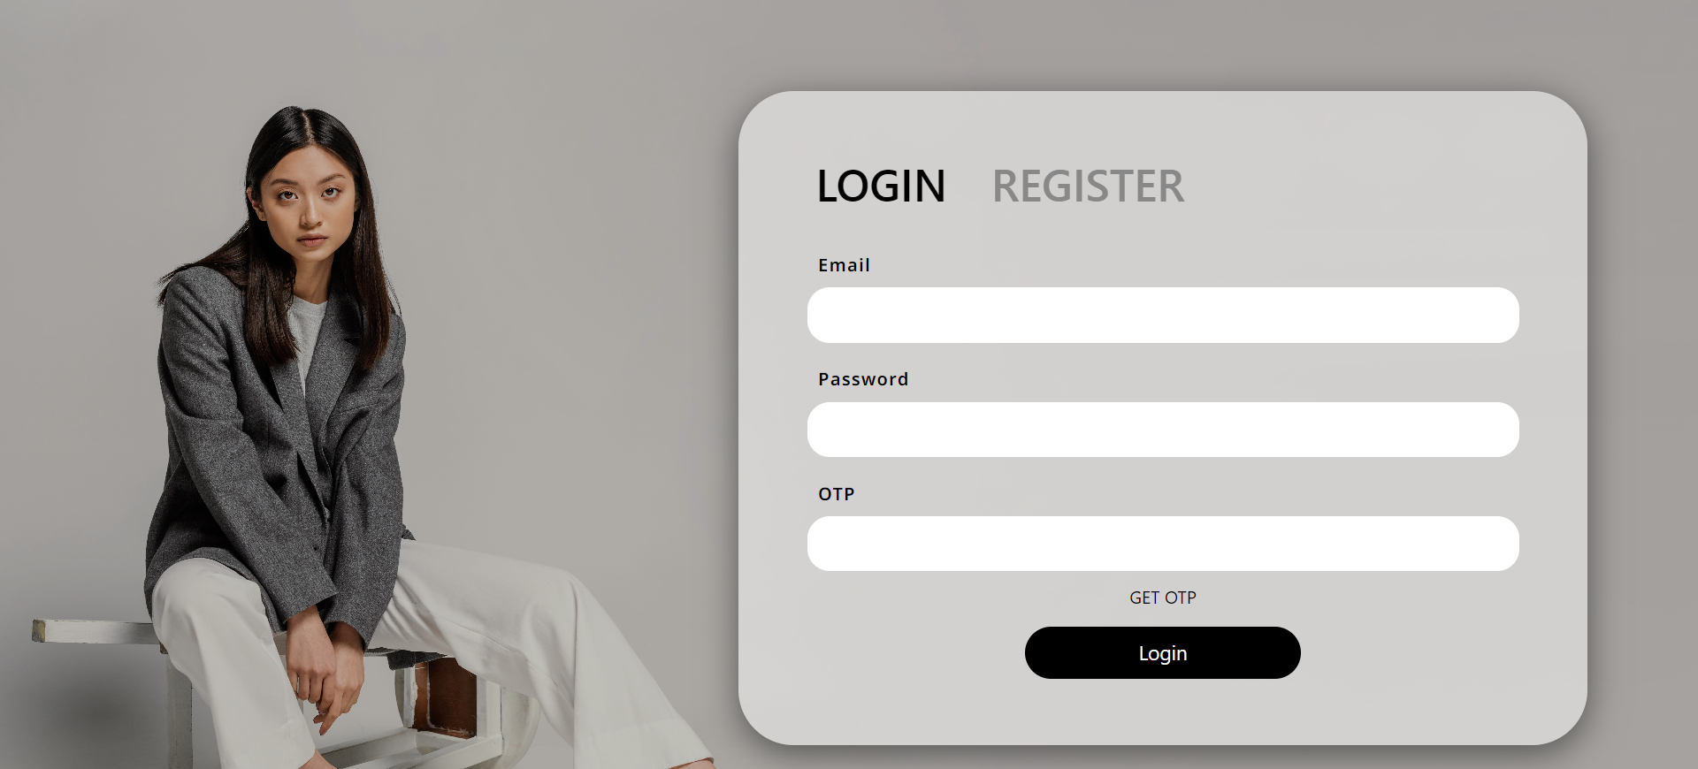
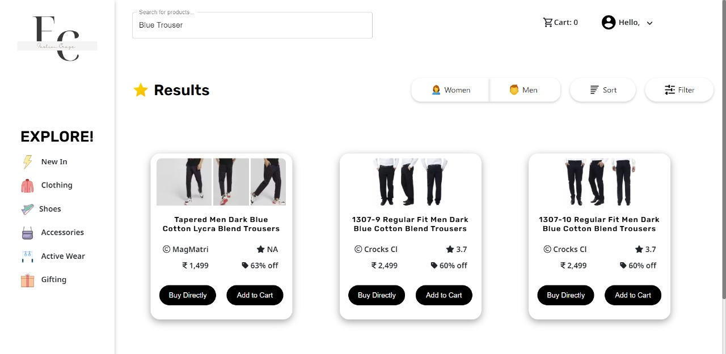
Deliverables/Expectations for Level 2 (Idea + Code Submission)
Our Project yields a personalized AI-driven fashion outfit generator for Flipkart, offering tailored recommendations based on user history and preferences.
Integrating real-time trends ensures users stay fashion-forward.
A conversational interface empowers users to engage and have a seemless experience;
This will enrich shopping experiences, inspires fashion choices, saves time, and fosters user engagement, ultimately enhancing the Flipkart platform.

Slide 4
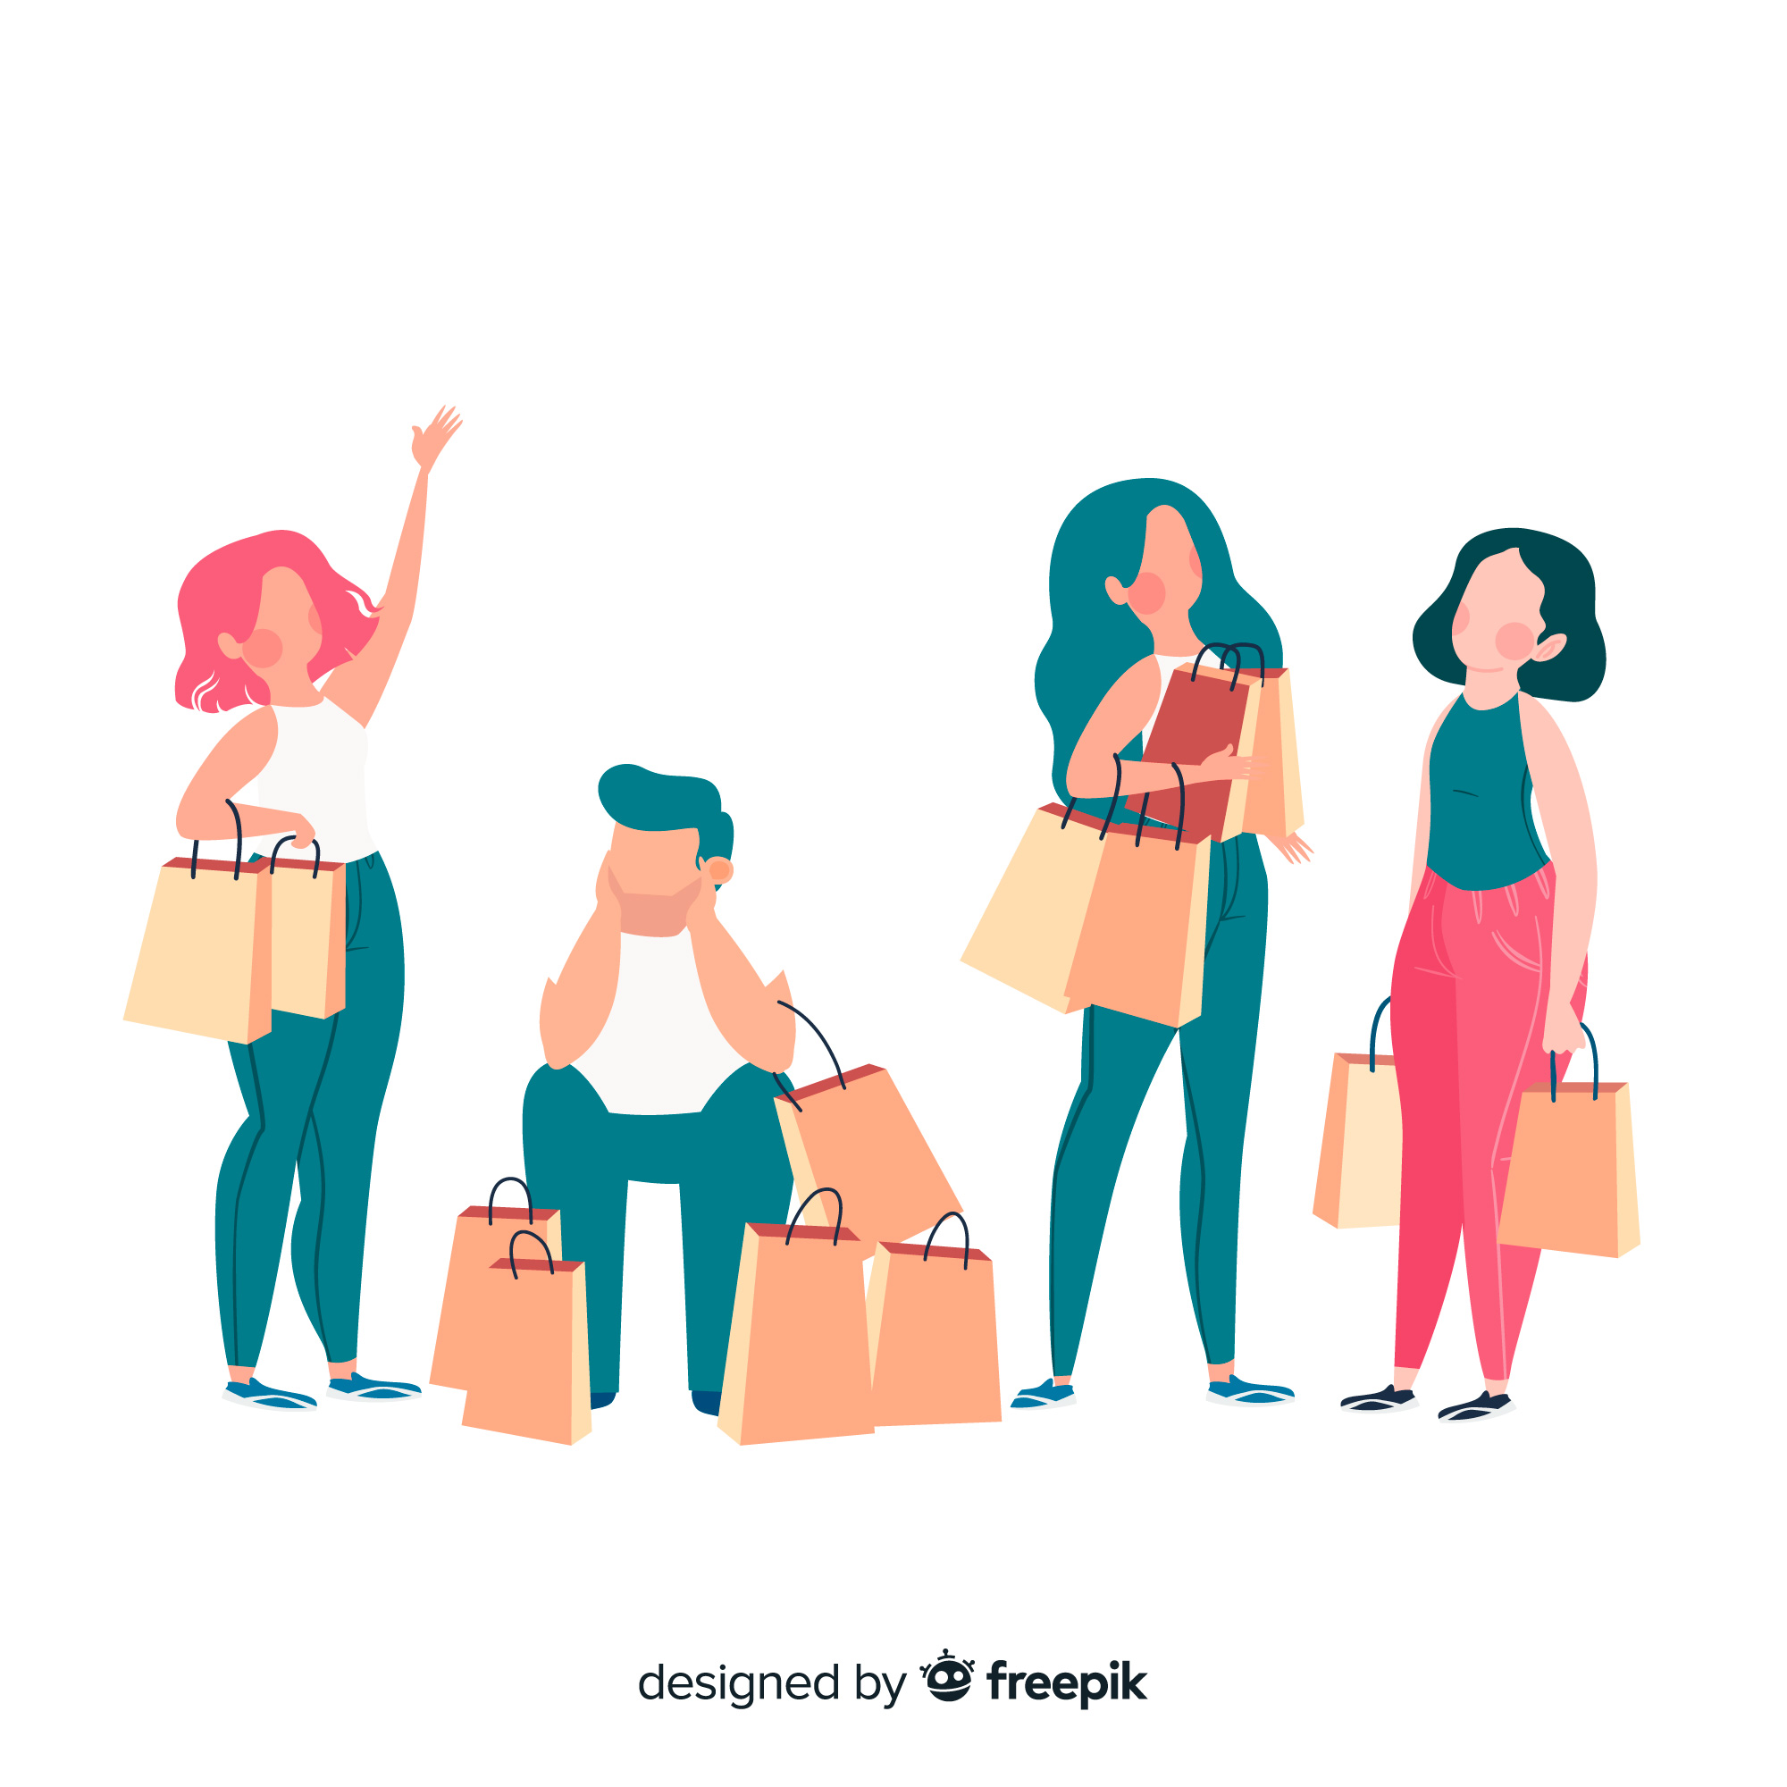
Idea behind the solution
So, the challenge involves creating an advanced Gen AI-powered fashion outfit generator for Flipkart, transforming personalized fashion discovery through natural conversations. This entails understanding nuanced user preferences, involving purchase history, styles, colors, and brands, employing advanced machine learning.
The complexity increases with real-time recommendation refinement considering user actions like past shopping history and cart activity. The ultimate goal is a seamless fashion experience on Flipkart, combining personalized recommendations with current trends.

Slide 5
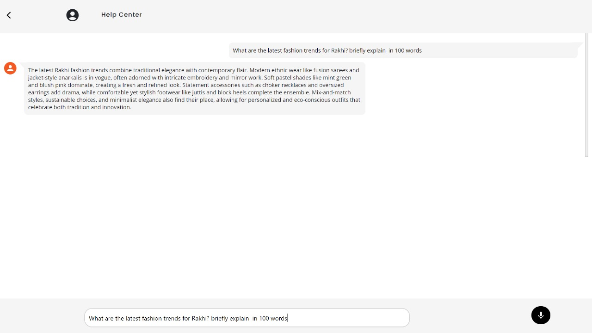
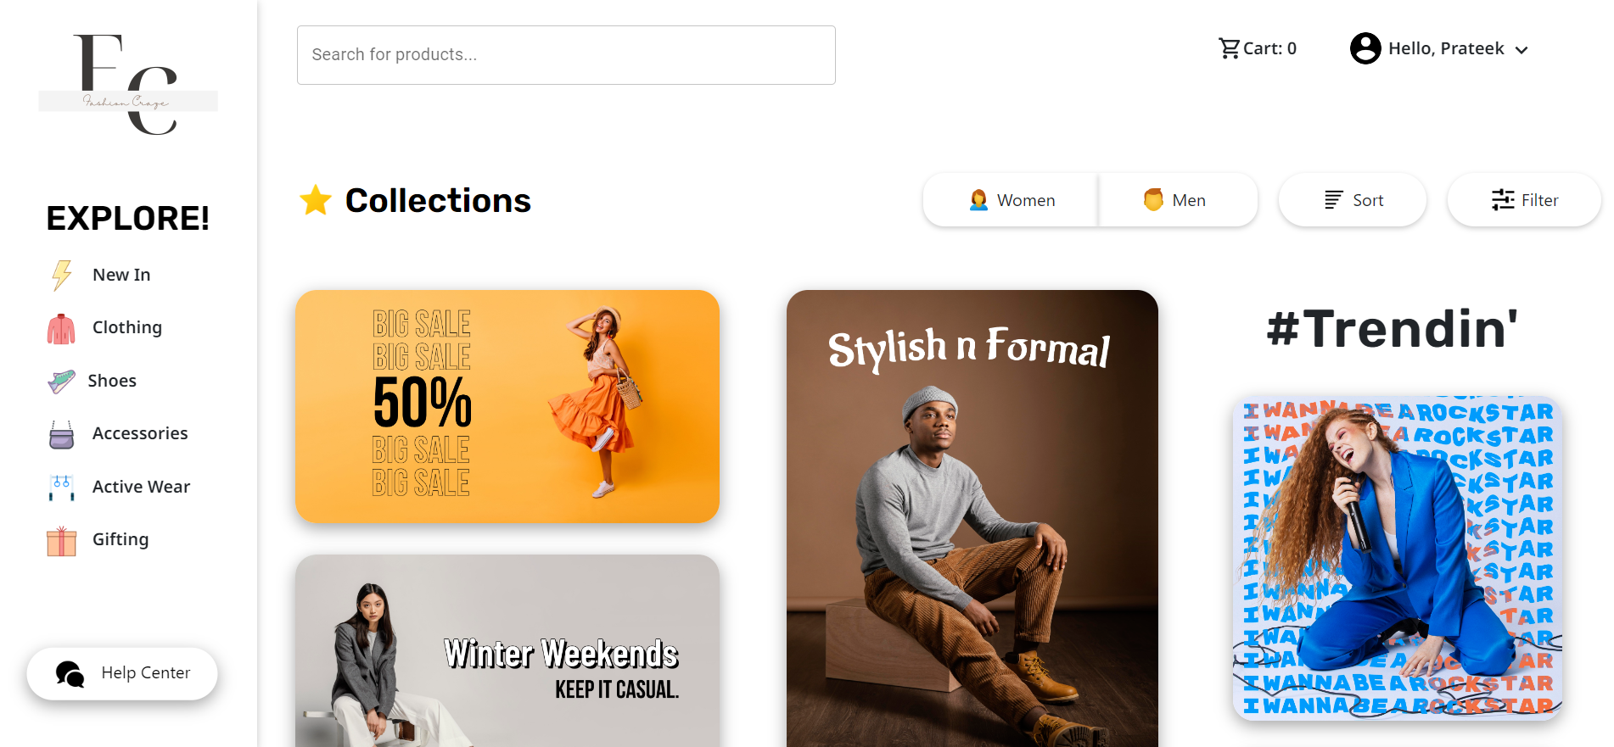
Solution statement/ Proposed approach
We've developed a user-centric web application that takes fashion discovery to the next level. By leveraging an individual's past purchasing history, our platform offers personalized recommendations that align with their unique preferences.
Enhancing this experience further, our assistive-chatbot, powered by OpenAI APIs, provides real-time assistance, guiding users through the latest trends and answering any questions they have. Seamlessly integrating advanced technology and user-centered design, our platform transforms shopping into a personalized, interactive journey, setting a new benchmark for fashion exploration.

Slide 6

Use-cases
Social Media Trend Adaptation
Stay stylish on social media with tailored trend
suggestions for GenZ users.
Personalized Shopping Recommendations
Elevate your shopping experience with personalized
product suggestions based on your history.
Fashion Prediction using GenAI
Discover your perfect style using GenAI’s predictive
fashion insights from your past choices.
Virtual Wardrobe Planning
Effortlessly plan outfits using virtual wardrobe
coordination from your past shopping history.

Slide 7

Limitations
Scalability
Our Project struggles with website load, this could be
optimized by adding load balancers.
Limited Dataset
We had access to a very minimal data, with availability
of more data, we can improve our model’s performance in
future.
Paid APIs
Currently, we are using third-party paid APIs. Dependence
on costly third-party APIs adds financial strain.
Third-Party APIs
Building custom APIs is an option, but we had limited
time. In future, we can use tailor-made APIs

Slide 8

Future Scope
Initially the project is limited to clothing, it can later be extended to other categories as well
Collaborating with brands for personalized clothing collections based on user preferences
Partnering with other apps to integrate additional user data for improved personalization
Incorporating AR for virtual outfit try-ons and immersive shopping experiences

Slide 9
Thank You

